Slide 1
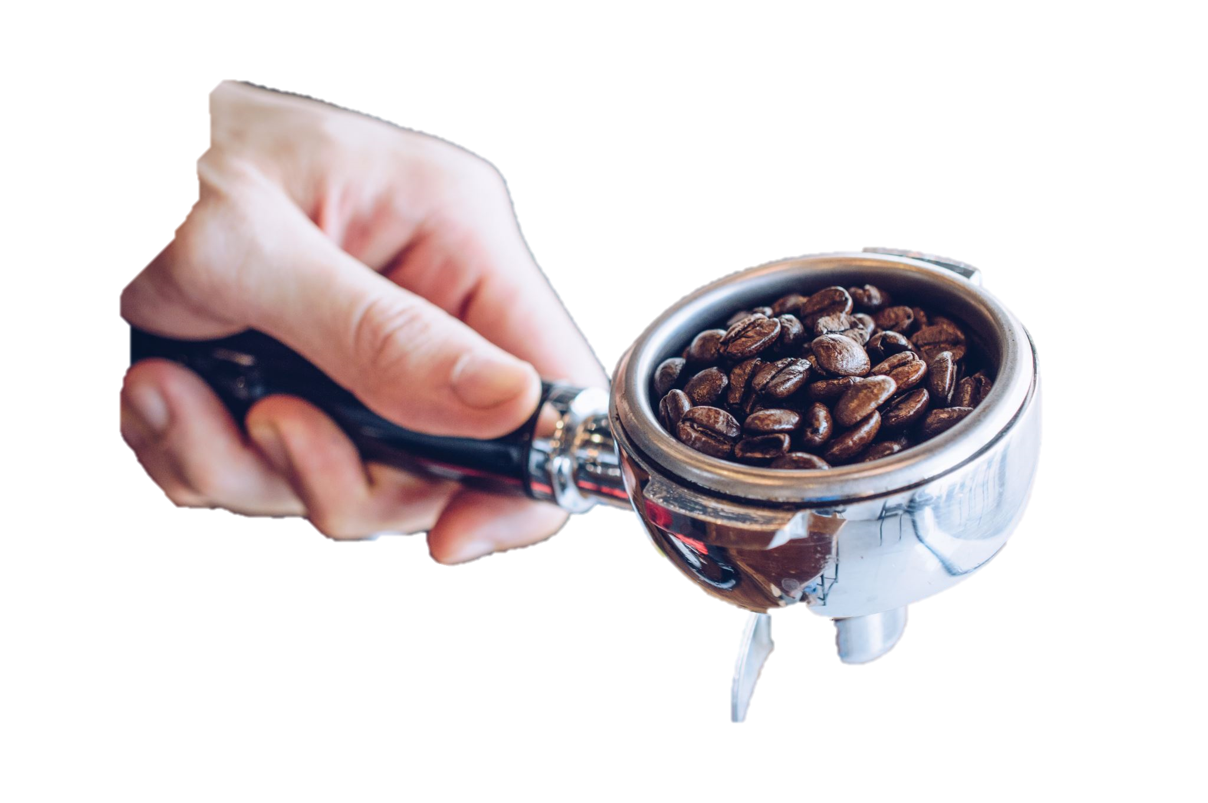
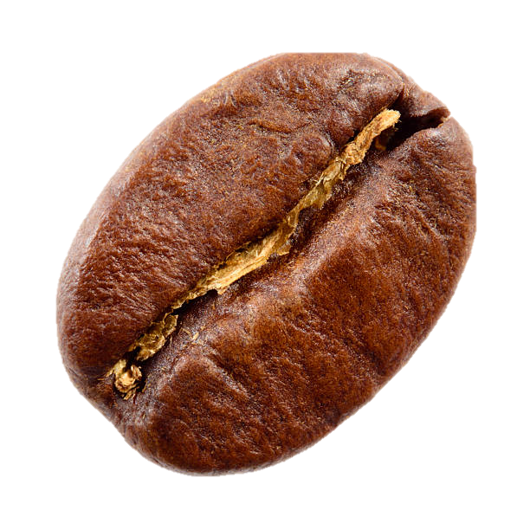
BRIGHT COFFEE ANALYTICS

Slide 2
BRIGHT COFFEE ANALYTICS
By: Primrose Lekala

Slide 3
Purpose
Illustrate the coffee shops performance in hopes to grow the Bright Coffee Shop revenues and product performance

Slide 4
Sales data has been collected from the 3 stores over a period of 6 months
(January-June)

Slide 5
Insights

Slide 6
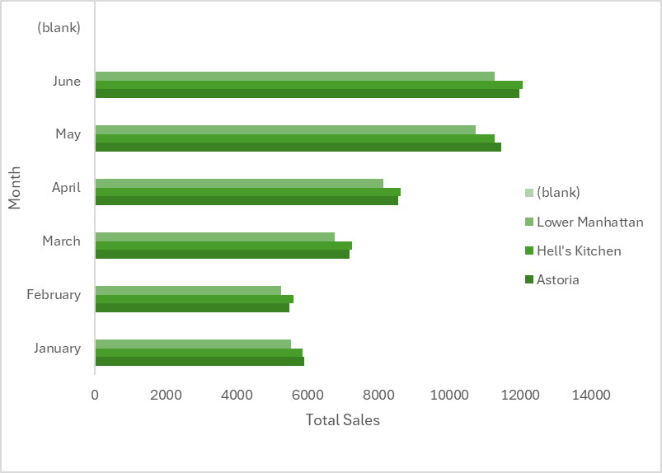
Store’s monthly performance

Slide 7
Store’s popular items

Slide 8
Sales trends at given times

Slide 9
Top 10 Product revenue
Product type | Revenue
Barista Espresso | R91406.20
Brewed Chai tea | R77081.95
Hot chocolate | R72416.00
Gourmet brewed coffee | R70034.60
Brewed Black tea | R47932.00
Brewed herbal tea | R47539.50
Premium brewed coffee | R38781.15
Organic brewed coffee | R37746.50
Scone | R36866.12
Drip coffee | R31984.00

Slide 10
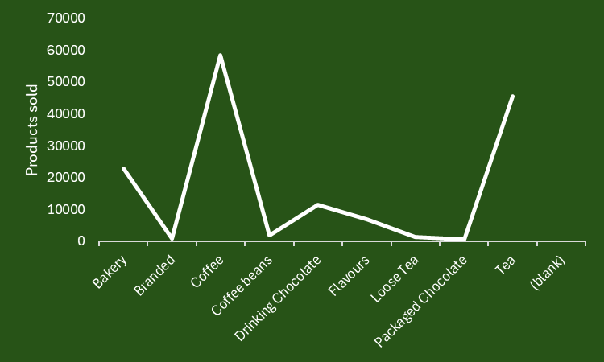

Slide 11
Ways to increase revenue and combat sales of low performing products

Slide 12


Buy 1 get 1 free promotion on low sale products
Get a price/product of choice after buying 10 of the selected products in a row (punch card system)
Run a competition where customers enter their receipts of >= R……. Where they stand a chance to win a weeks supply of coffee
Reduce/increase the prices of low sale products
Run time specific specials (e.g Morning combo specials)

